Slide 1
SQL Server on the Microsoft Azure Platform SQL Server Ground to Cloud Workshop

Slide 2
Modernizing the WideWorldImporters Gaming Division
Primarily SQL Server 2008 R2
Expensive ETL applications for data sources outside of SQL Server
Should we use “Big Data” technologies?
Query performance tuning expensive
Some database applications suffer from I/O performance
Need data secure end-to-end with classification and auditing
Applications need better availability and less downtime
Our company uses a mixture of different operating system platforms
Popularity of containerized applications growing
What, when, and how should I migrate to the cloud?
Desire to build more intelligent applications with AI and Machine Learning

Slide 3
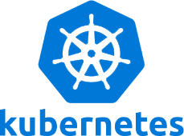

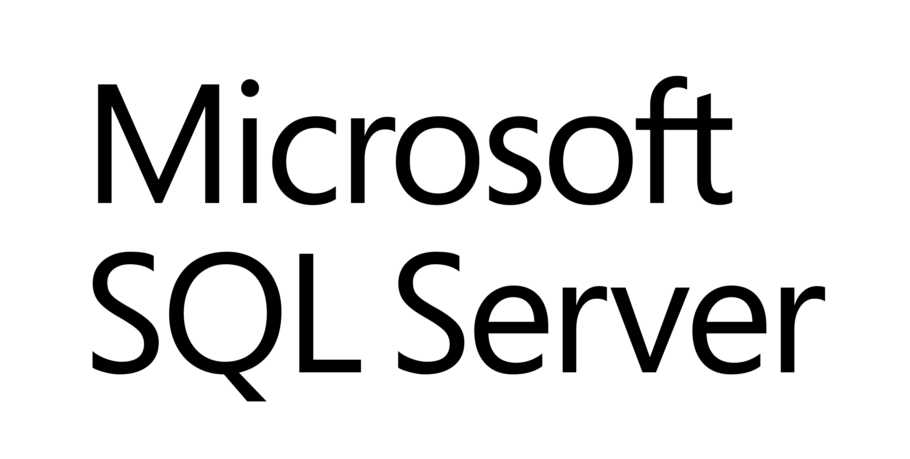
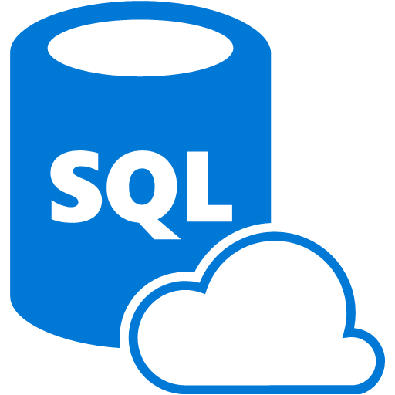
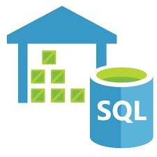
Azure Data Modernization Choices
WWI
SQL Server 2016
SQL Server 2017
SQL Server 2019
SQL
SQL Server in
Azure Virtual Machine (IAAS)
SQL
SQL Server 2008
SQL Server 2008R2
SQL Server 2012
SQL Server 2014
Azure SQL Database
Azure SQL Database Managed Instance
(PAAS)
Azure SQL Data
Warehouse

Slide 4

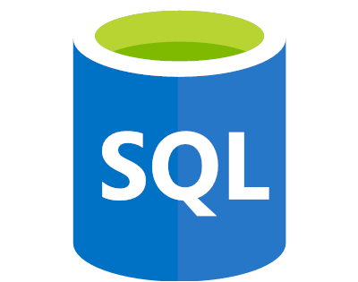
Azure SQL
SQL virtual machines
Managed instances
Databases
Best for migrations and applications requiring OS-level access
Best for most lift-and-shift migrations to the cloud
Best for modern cloud applications. Hyperscale and serverless options are available
SQL virtual machine
Single instance
Single database
Elastic pool
SQL Server and OS server access
Expansive SQL And OS version support
Automated manageability features for SQL Server
SQL Server surface area (vast majority)
Native virtual network support
Fully managed service
Hyperscale storage (up to 100TB)
Serverless compute
Fully managed service
Resource sharing between multiple databases to price optimize
Simplified performance management for multiple databases
Fully managed service
Notes:
Note the wording was taken directly from the final review Rainbow wording

Slide 5
SQL Virtual Machines

Slide 6
SQL Managed instance

Slide 7
SQL Database singleton

Slide 8
SQL Database elastic pools

Slide 9

SQL Server 2019 comparison to Azure SQL
Feature | SQL Server 2019 | Azure SQL
Intelligent Query Processing
Lightweight Query Profiling
In-Memory Database
Always Encrypted with Enclaves
Data Classification
Accelerated Database Recovery
UTF-8
Extensibility Framework
Polybase Data Virtualization
*
*
In-Memory OLTP exists in both SQL Server and Azure

Slide 10
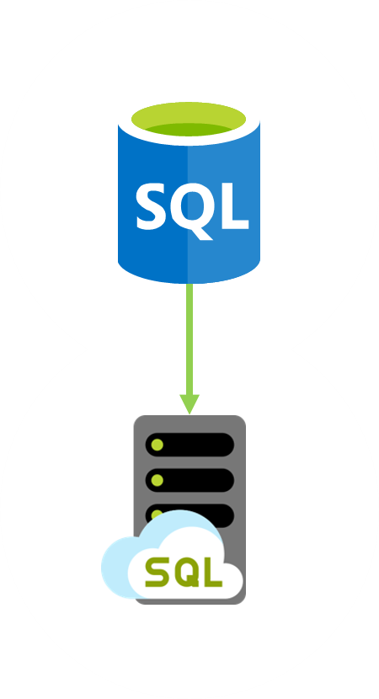
Customer situation
Tailspin Toys is online gaming company experiencing exponential growth
Struggling to manage expanding database infrastructure
Lacking ability to scale
Looking to migrate gaming services to the cloud

Slide 11
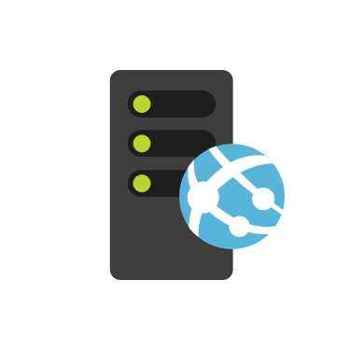
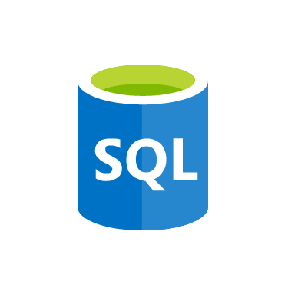
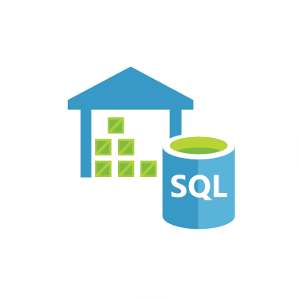
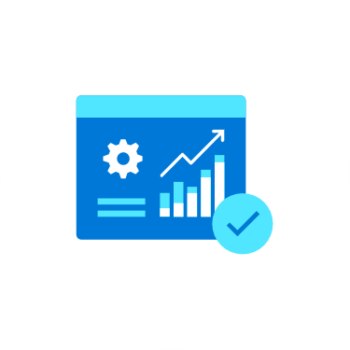
Customer situation
Gaming
Service
VMs
SQL 2008
Databases
Data
Warehouse
Reports
Notes:
Gaming services and authentication VMs
Lift-and-shift
Gaming databases
SQL Server 2008 R2
Looking at PaaS if possible
Running Service broker feature
Data warehouse
SQL Server 2008 R2
Lots of reports
Direct connections by developers and customer service
Data fed via SSIS jobs, hourly
Reports
SSAS cubes feed reports
SSRS reports
Sent to SharePoint

Slide 12

Customer objections
Looking for comparison of SQL database hosting options in Azure.
What tools can help a evaluate databases against target platforms and identify potential issues?
Can we have network isolation and secure channel access from on-premises?
Don’t want to be locked into a cloud vendor.

Slide 13


Preferred solution
Azure Hybrid Benefit
Prepay for reserved capacity
Azure Database Migration Service
Azure Site Recovery
Partner engagement
Notes:
Cost minimization
Azure Hybrid Benefit
Reserved capacity payments
DMS
3 month timeframe
DMS
ASR
Partner engagement
Dedicated resources

Slide 14
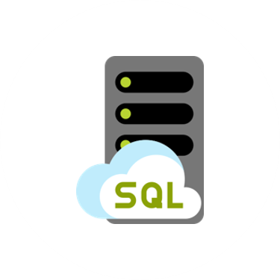

Preferred solution - PoC
Gaming
Service
VMs
SQL MI
Databases
SQL DB
Hyperscale
Data
Warehouse
Power BI
Reports
Notes:
Gaming services and authentication VMs for 1 game
Gaming and auth databases
SQL MI Business critical for games, and GP for auth
Data warehouse
SQL DB Hyperscale
ADF to replace SSIS packages
Reports
Azure Analysis Services
Power BI

Slide 15
Preferred solution – IaaS vs PaaS
Cost
Administration
SLAs
Time to move

Slide 16

Preferred solution – Recommended database
Azure SQL Database Managed Instance
Platform-as-a-Service (PaaS)
Supports database migration from on-premises with minimal to no database changes
Provides all of the PaaS benefits of Azure SQL Database but adds capabilities that were previously only available in SQL VMs
Includes a native virtual network (VNet) and near 100% compatibility with on-premises SQL Server
Notes:
Managed instance is a new deployment option of Azure SQL Database, providing near 100% compatibility with the latest SQL Server on-premises (Enterprise Edition) Database Engine.
Provides a native virtual network (VNet) implementation that addresses common security concerns, and a business model favorable for on-premises SQL Server customers.
The managed instance deployment model allows existing SQL Server customers to lift and shift their on-premises applications to the cloud with minimal application and database changes.
At the same time, the managed instance deployment option preserves all PaaS capabilities (automatic patching and version updates, automated backups, high-availability ), that drastically reduces management overhead and TCO.
Adds features that are not available in Azure SQL Database, such as cross-database queries, linked servers, CLR modules, and Service Broker.

Slide 17
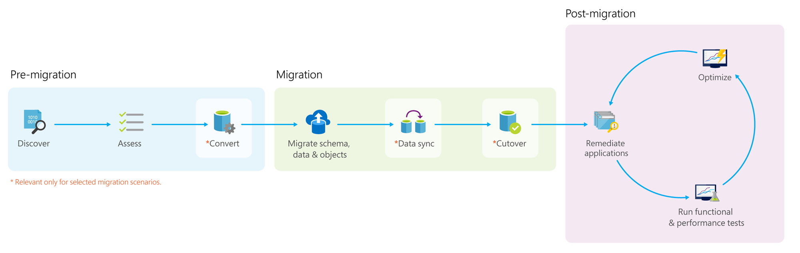
Preferred solution – Data migration
Notes:
*Pre-migration*:
- **Discover**: Inventory your source database assets and perform an application stack discovery.
- **Assess**: Assess source workloads and fix recommendations.
- **Convert**: Convert the source schema to work in the target environment. This is only relevant for heterogeneous migrations.
*Migration*:
- **Migrate schema, data, and objects**: Migrate the source schema and then migrate the source data to the target.
- **Sync data**: Sync your target schema and data with the source. This is only relevant for minimal-downtime migrations.
- **Cutover**: Cut over from the source to the target environment. This is only relevant for minimal-downtime migrations.
*Post-migration*:
- **Remediate applications**: Iteratively make any necessary changes to your applications.
- **Perform Tests**: Iteratively run functional and performance tests.
- **Optimize**: Based on the tests you performed, address any performance issues and then retest to confirm the performance improvements.

Slide 18
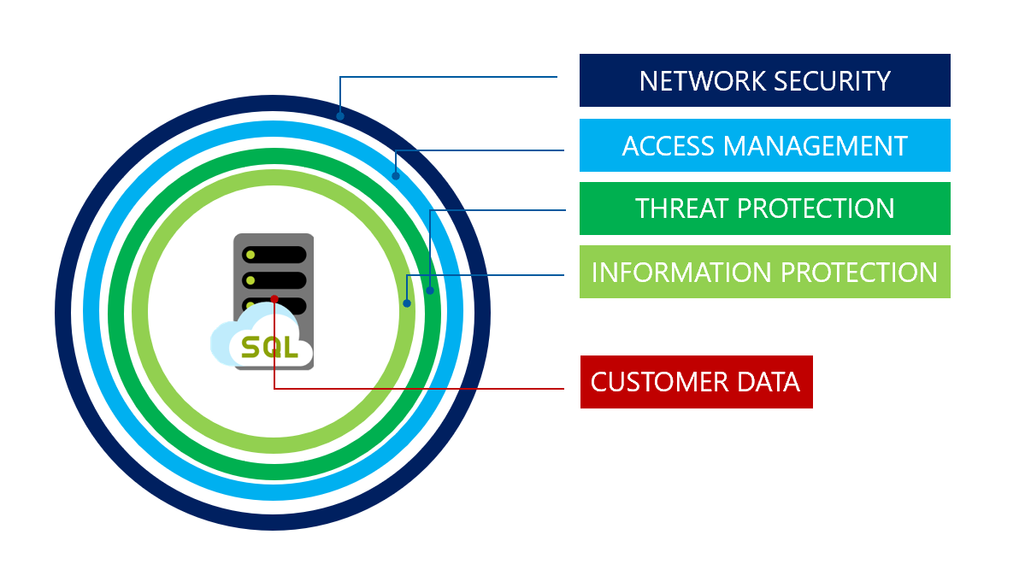
Preferred solution – Database security
Notes:
SQL MI includes numerous security tools that could be leveraged by Tailspin Toys, including:
SQL Database Advance Data Security
SQL Data Discovery and Classification
SQL Vulnerability Assessment service
Advanced Threat Detection
Transparent Data Encryption
Dynamic Data Masking
Row-level security

Slide 19
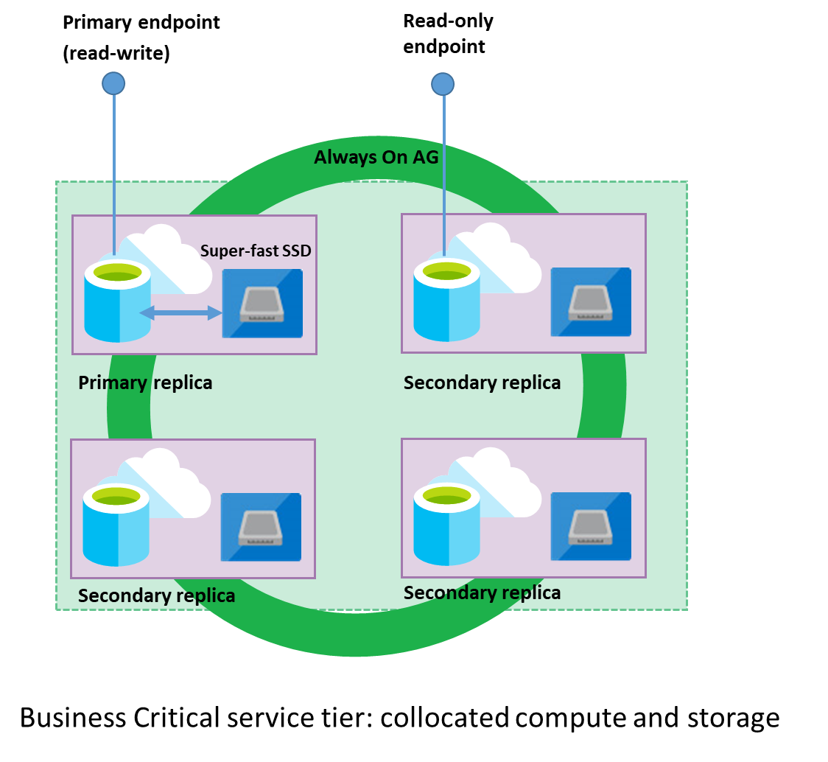
Preferred solution – Read-only reporting
Read Scale-out
Read-only replica
Free with SQL MI BC

Slide 20
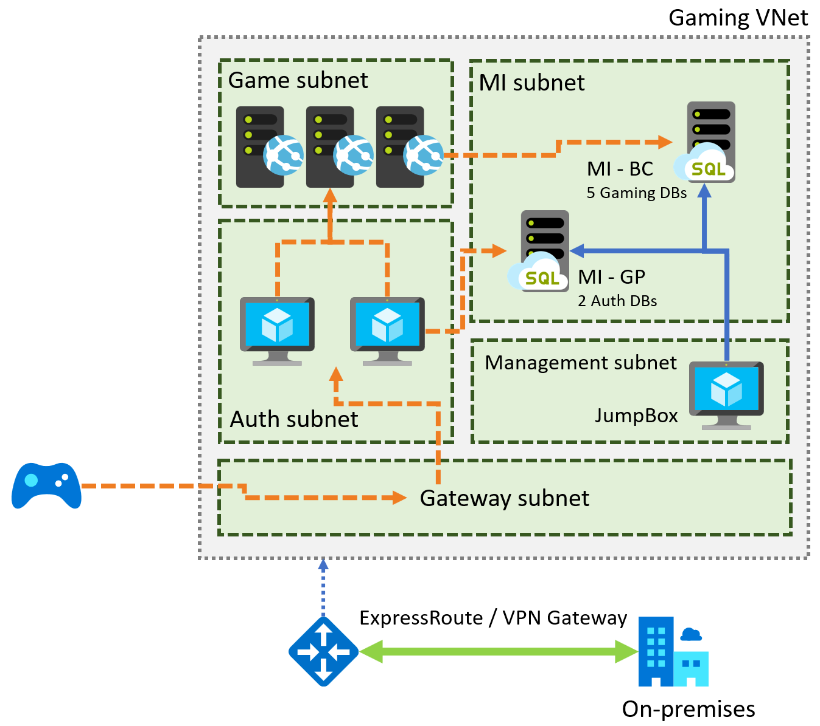
Preferred solution – Gaming services
Notes:
Diagram of the preferred solution for the gaming services. The gaming services are hosted in a VNet, with subnets for MI, Game, Management, Auth, and a Gateway subnet. SQL MI instances are hosted in the MI subnet. Gaming IaaS VMs are hosted in the Game subnet. Authorization VMs are in the Auth subnet, and a JumpBox is in the Management subnet. On-premises resources can access the VNet through ExpressRoute or a VPN gateway.

Slide 21
Preferred solution – Gaming services
Azure Site Recovery to migrate VMs
Multi-region deployments to address latency
VM scale sets for scalability of VMs
Availability Zones for high-availability

Slide 22
Preferred solution – Regional outages
Availability Zones for VMs
Auto-failover groups in SQL MI (in public preview)
Geo-restore and geo-replication for DW
Notes:
NOTE: Auto-failover groups for Managed Instance is currently in public preview. For customers who object to using a preview feature, a manual failover process would need to be implemented. This could involve setting up transactional replication to another SQL MI in a different region. VNet peering would need to be established between the virtual networks.

Slide 23
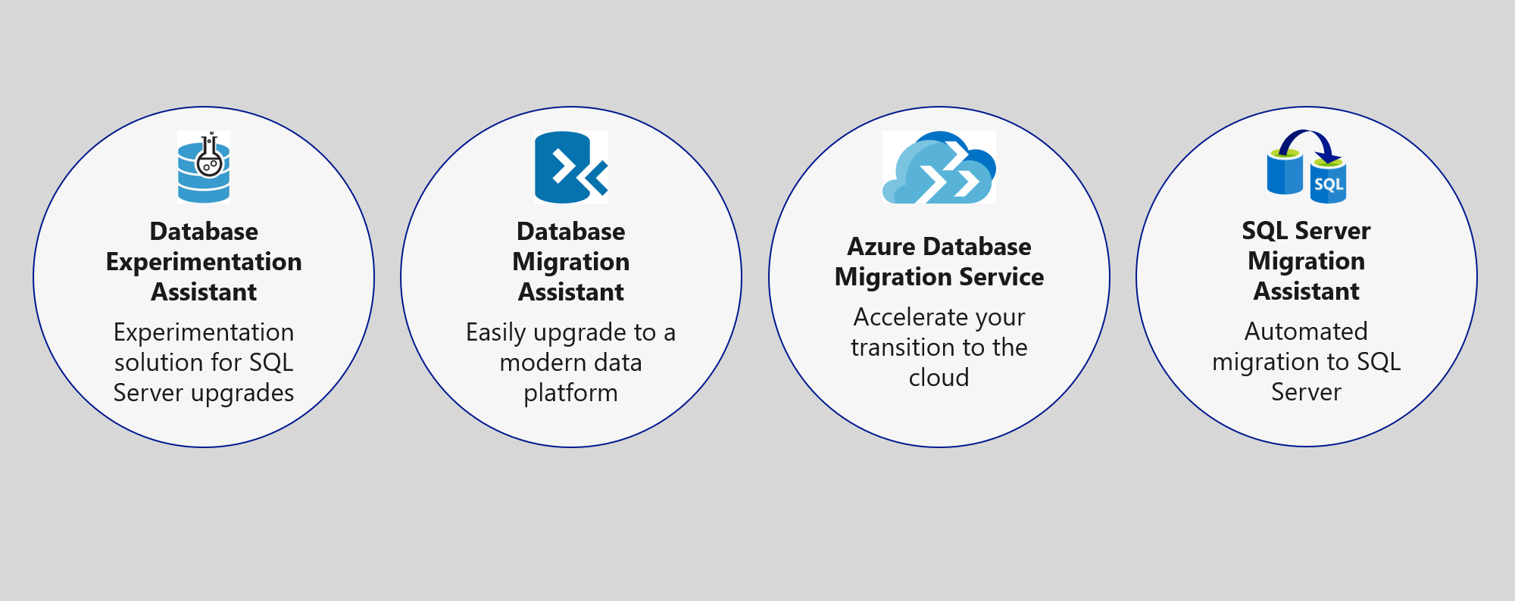
Upgrade & migration tools
Notes:
The Azure SQL data platform consists of three options:
SQL Server on an Azure VM
Azure SQL Database Managed Instance
Azure SQL Database
Each of the options will be discussed in more detail in the slides that follow.

Slide 24
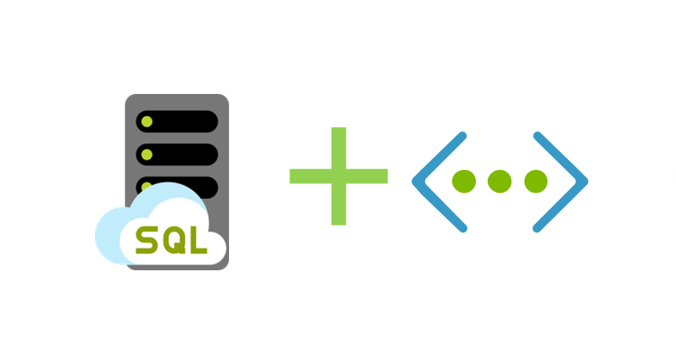
Network isolation
Notes:
SQL MI is deployed into an isolated Vnet
Subnets are used to allow access to SQL MI
On-premises access can be granted through ExpressRoute or a VPN Gateway

Slide 25
Cloud vendor lock-in
PaaS database services can be used
Use transactional replication to move data out

Slide 26
What you will learn in this workshop
Feature exists in Azure SQL Database
Connect to Azure SQL Database
Gain Performance with no application changes
Intelligent Query Processing
Need to classify and audit your data?
Data Classification and Auditing
Long running transactions affect your availability
Accelerated Database Recovery
Want external access with no data movement?
Data Virtualization
Is SQL Server on Linux and Containers compatible?
SQL Server Replication in one command
Each of these are independent modules
Want slides to learn more?
https://aka.ms/bobwardms
https://github.com/microsoft/sqlworkshops/tree/master/sql2019lab/slides

Slide 27
Learn more
http://aka.ms/annalytics
twitter: @AnalyticAnna
Use our free training at https://aka.ms/sqlworkshops
Learn from videos and demos at https://aka.ms/sqldbonyoutube
Download and try it at http://aka.ms/ss19
What’s new for SQL 2019 documentation
Sign-up for the EAP program at https://aka.ms/eapsignup

Slide 28
Customer situation
Tailspin Toys is online gaming company experiencing exponential growth
Struggling to manage expanding database infrastructure
Lacking ability to scale
Looking to migrate gaming services to the cloud

Slide 29
Customer situation
Gaming
Service
VMs
SQL 2008
Databases
Data
Warehouse
Reports
Notes:
Gaming services and authentication VMs
Lift-and-shift
Gaming databases
SQL Server 2008 R2
Looking at PaaS if possible
Running Service broker feature
Data warehouse
SQL Server 2008 R2
Lots of reports
Direct connections by developers and customer service
Data fed via SSIS jobs, hourly
Reports
SSAS cubes feed reports
SSRS reports
Sent to SharePoint

Slide 30
Customer objections
Looking for comparison of SQL database hosting options in Azure.
What tools can help a evaluate databases against target platforms and identify potential issues?
Can we have network isolation and secure channel access from on-premises?
Don’t want to be locked into a cloud vendor.

Slide 31
Preferred solution
Azure Hybrid Benefit
Prepay for reserved capacity
Azure Database Migration Service
Azure Site Recovery
Partner engagement
Notes:
Cost minimization
Azure Hybrid Benefit
Reserved capacity payments
DMS
3 month timeframe
DMS
ASR
Partner engagement
Dedicated resources

Slide 32
Preferred solution - PoC
Gaming
Service
VMs
SQL MI
Databases
SQL DB
Hyperscale
Data
Warehouse
Power BI
Reports
Notes:
Gaming services and authentication VMs for 1 game
Gaming and auth databases
SQL MI Business critical for games, and GP for auth
Data warehouse
SQL DB Hyperscale
ADF to replace SSIS packages
Reports
Azure Analysis Services
Power BI

Slide 33
Preferred solution – IaaS vs PaaS
Cost
Administration
SLAs
Time to move

Slide 34
Preferred solution – Recommended database
Azure SQL Database Managed Instance
Platform-as-a-Service (PaaS)
Supports database migration from on-premises with minimal to no database changes
Provides all of the PaaS benefits of Azure SQL Database but adds capabilities that were previously only available in SQL VMs
Includes a native virtual network (VNet) and near 100% compatibility with on-premises SQL Server
Notes:
Managed instance is a new deployment option of Azure SQL Database, providing near 100% compatibility with the latest SQL Server on-premises (Enterprise Edition) Database Engine.
Provides a native virtual network (VNet) implementation that addresses common security concerns, and a business model favorable for on-premises SQL Server customers.
The managed instance deployment model allows existing SQL Server customers to lift and shift their on-premises applications to the cloud with minimal application and database changes.
At the same time, the managed instance deployment option preserves all PaaS capabilities (automatic patching and version updates, automated backups, high-availability ), that drastically reduces management overhead and TCO.
Adds features that are not available in Azure SQL Database, such as cross-database queries, linked servers, CLR modules, and Service Broker.

Slide 35
Preferred solution – Data migration
Notes:
*Pre-migration*:
- **Discover**: Inventory your source database assets and perform an application stack discovery.
- **Assess**: Assess source workloads and fix recommendations.
- **Convert**: Convert the source schema to work in the target environment. This is only relevant for heterogeneous migrations.
*Migration*:
- **Migrate schema, data, and objects**: Migrate the source schema and then migrate the source data to the target.
- **Sync data**: Sync your target schema and data with the source. This is only relevant for minimal-downtime migrations.
- **Cutover**: Cut over from the source to the target environment. This is only relevant for minimal-downtime migrations.
*Post-migration*:
- **Remediate applications**: Iteratively make any necessary changes to your applications.
- **Perform Tests**: Iteratively run functional and performance tests.
- **Optimize**: Based on the tests you performed, address any performance issues and then retest to confirm the performance improvements.

Slide 36
Preferred solution – Database security
Notes:
SQL MI includes numerous security tools that could be leveraged by Tailspin Toys, including:
SQL Database Advance Data Security
SQL Data Discovery and Classification
SQL Vulnerability Assessment service
Advanced Threat Detection
Transparent Data Encryption
Dynamic Data Masking
Row-level security

Slide 37
Preferred solution – Read-only reporting
Read Scale-out
Read-only replica
Free with SQL MI BC

Slide 38
Preferred solution – Gaming services
Notes:
Diagram of the preferred solution for the gaming services. The gaming services are hosted in a VNet, with subnets for MI, Game, Management, Auth, and a Gateway subnet. SQL MI instances are hosted in the MI subnet. Gaming IaaS VMs are hosted in the Game subnet. Authorization VMs are in the Auth subnet, and a JumpBox is in the Management subnet. On-premises resources can access the VNet through ExpressRoute or a VPN gateway.

Slide 39
Preferred solution – Gaming services
Azure Site Recovery to migrate VMs
Multi-region deployments to address latency
VM scale sets for scalability of VMs
Availability Zones for high-availability

Slide 40
Preferred solution – Regional outages
Availability Zones for VMs
Auto-failover groups in SQL MI (in public preview)
Geo-restore and geo-replication for DW
Notes:
NOTE: Auto-failover groups for Managed Instance is currently in public preview. For customers who object to using a preview feature, a manual failover process would need to be implemented. This could involve setting up transactional replication to another SQL MI in a different region. VNet peering would need to be established between the virtual networks.

Slide 41
Upgrade & migration tools
Notes:
The Azure SQL data platform consists of three options:
SQL Server on an Azure VM
Azure SQL Database Managed Instance
Azure SQL Database
Each of the options will be discussed in more detail in the slides that follow.

Slide 42
Network isolation
Notes:
SQL MI is deployed into an isolated Vnet
Subnets are used to allow access to SQL MI
On-premises access can be granted through ExpressRoute or a VPN Gateway

Slide 43
Cloud vendor lock-in
PaaS database services can be used
Use transactional replication to move data out

